Slide 1
Volleyball Data Format

Slide 2
Types of player actions
Serve
Receive/Pass
Set
Attack
Block
Dig
Free Ball

Slide 3
Action evaluations
= (error)
/
-
!
+
# (perfect/point scored)

Slide 4
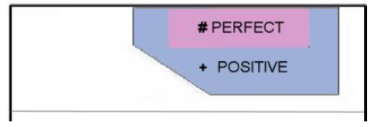
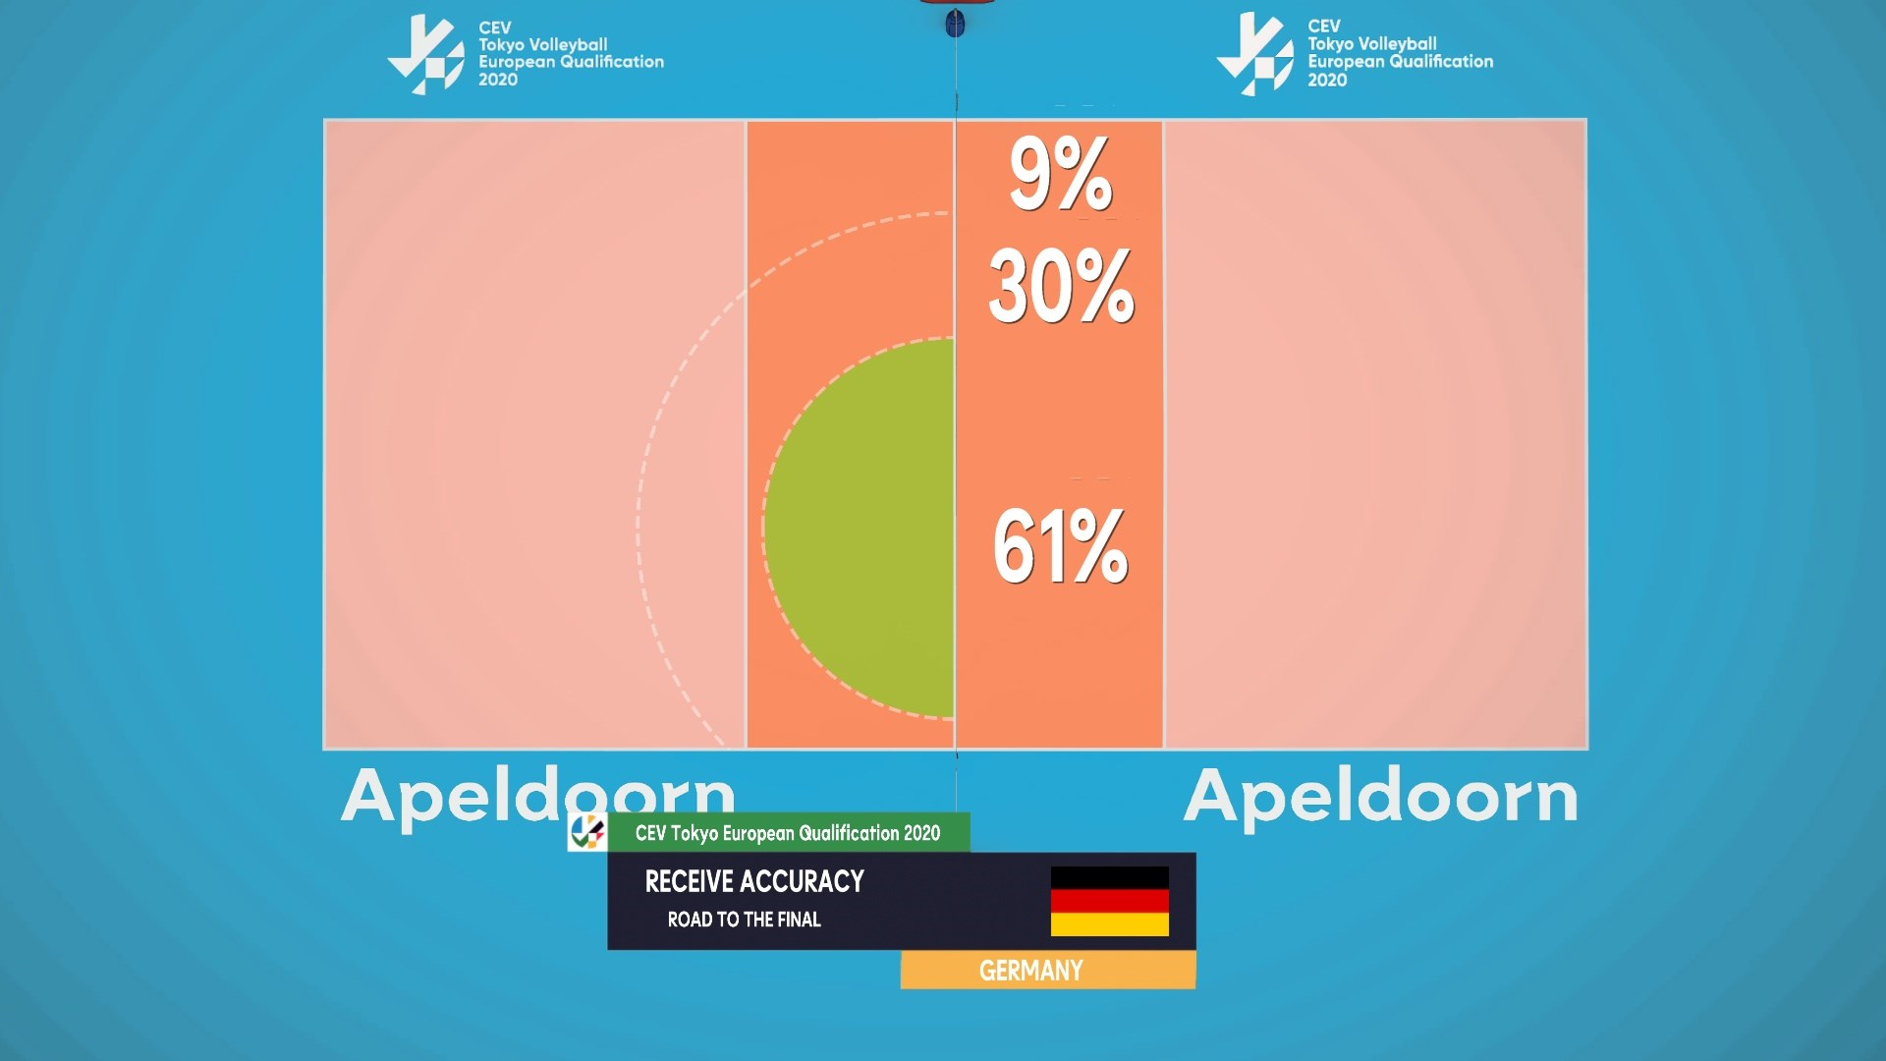
Example: Serve Receive Evaluation
# perfect
+ positive
!
-
/ overpass
= ace

Slide 5
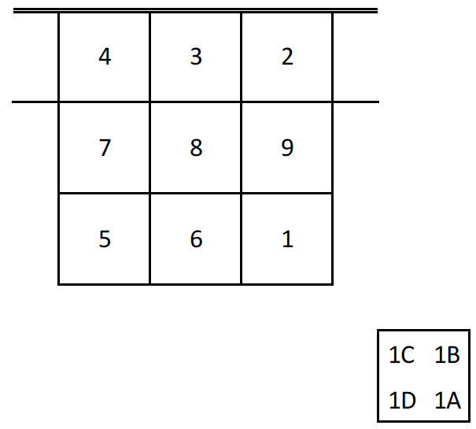
Ball Trajectories
Serve and Attack codes include start and end locations of ball
Set codes can include ball location
Precision isn’t spectacular
Set codes not always present
Block interference with attack

Slide 6
Action Code Details
Every action has further optional detail
Serve: spin or float serve
Receive: forearm or hand receive, which side of the body
Set: middle attacker combination, actual set decision
Attack: quick/high set, outside/middle, hard hit/tip, quality of block on opponent side (1,2,3 man block)

Slide 7
Video and time sync
Actions can optionally be assigned time stamps in seconds in corresponding video file
Manual process but reasonably quick with practice
Accuracy not spectacular though

Slide 8
Data Volley Format
Each game in its own DVW file
Sections for game information, team roster, some user adjustable settings
Sequence of codes, augmented with current score and player rotation information
Can read and convert to CSV using my software

Slide 9
Sources of data
My work with UBC: all UBC games (regular season and preseason) in last 3 seasons and some additional games between other teams in league. 2019/2020 season has 84 games.
Volleymetrics: all university games in Canada West for last 2 seasons but sometimes questionable accuracy
I have some connections to potentially get all games in World League

